Slide 1
Algorithms & Code
Presented by: Shenesh Perera
Programming: Unit #1

Slide 2
Content
Introduction
Algorithm: Intended Purpose & Functions
Coding
Difference in algorithms & code at a glance for Binary Search
Coding flow
Code Execution
Summary

Slide 3
Introduction
By standard, programmers follow a life cycle during a development of a program called the Software Development Life Cycle(SDLC), in which there are 2 particular stages called Designing and Coding.
Algorithms, pseudo code, flow charts, ERDs, Class diagrams etc. are ways of designing the program.
Designing a program is the process by which the logic of the program is adequately captured in such a way that a programmer can understand. As such designing methods do not require a programming language, anything that is not logic of the program, should not be captured at this stage.
Coding a program is the process of producing substance of the logic that was written in the previous step, in order to obtain the intended output of the program. At this stage, usage of code standards, work flow models, programming languages, IDEs, linting etc. are crucial.

Slide 4
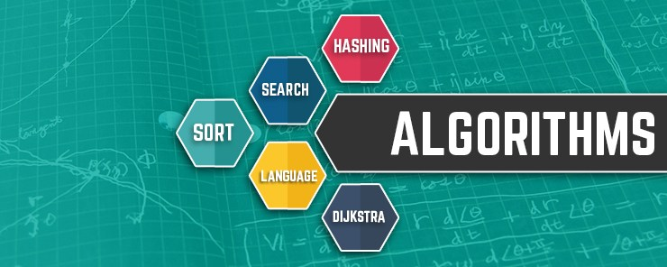
Algorithm: Intended Purpose & Functions
An algorithm is a series of steps or a set of rules that logically describes the intended flow of a program in order to gain an expected output.
Algorithms can be written in any natural language, as long as there is a comprehensible flow that can lead to a definite output. Therefore nearly anyone could write an algorithm.
However this does not mean that an algorithm is a fit for all situations and is the perfect method for capturing logic.
In programming, before coding it is well advised to write an algorithm so that the following qualities are maintained;
Precision- What must be done is clearly stated
Finite-The algorithm ensures that a limited number of instructions are executed
Generalization- The series defined in the algorithm applies to a multiple situations
Input & Output- It ensures an input is given and an output is obtained
Figure 1.0, blog.eudonix.com, August 10, 2017

Slide 5
Coding
Coding is the major part of development, in this stage every bit of information grasped during the previous steps are manipulated in order to produce a substantial product.
This stage must be done using a programming language, and can only be achieved through the knowledge of a programmer.
There are largely notable differences between code and an algorithm. An algorithm is always followed by coding but coding does not necessarily have to be preceded by the writing of an algorithm.
However if an algorithm has been written, and if it has failed to capture the entirety of the logic that the code should employ, then the coding will also inherit the problems(lack of instruction) the algorithm had.
Coding, although not noticeable, generally is a result of a lot of algorithms.

Slide 6
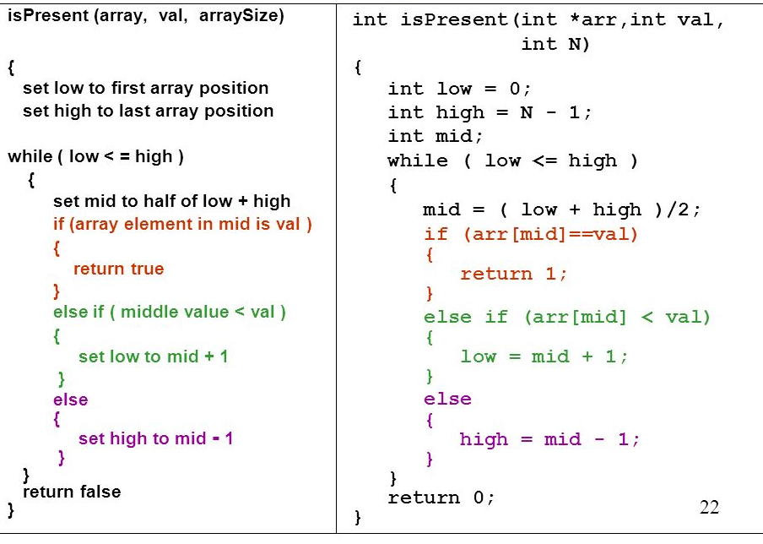
Difference in algorithms & code at a glance for Binary Search
Figure 1.2, slideplayer.com, May 12, 2015, Dylan McDaniel

Slide 7
In the figure 1.2, an algorithm has been written for a searching method called Binary Search using the programming language C++.
A simple look at the 2 identifies a clear difference, the algorithm part can be understood by anyone due to the usage of a natural language but the code variant can only be understood by a programmer that knows C++.
As such, algorithms can be effectively used to visualize logic to clients of New Lanka Hospital that do not have programming experience. A simple explanation can be provided in addition so that complex bits of the algorithm like loops can be understood.
The reason as to why algorithms are being used even in the modern age, is to establish efficient communication between clients and the designers.
One thing to also note is the fact that the code variant can be run, and understood by a machine but not an algorithm.
There are several steps to be followed even before code will provide any significant output.

Slide 8
Coding flow
In order for a seasoned programmer to reach the criteria thrown at him, he would follow a set of defined steps. I, personally suggest the following;
Comprehending the problem- When a problem is to be solved, reading whatever information provided is necessary until a general understanding has been reached
Dry Run- Produce a sample set of data that you expect as output from the program
Writing algorithms, pseudo code etc.- This will give you a rough foundation to work with, and the entirety of the logic will have been scoped fully.
Translate algorithms, pseudo code etc. to code & debug-Use a programming language to convert the logic into a functioning program to obtain data similar to what has been obtained in step 2.
Optimize- Repetitive code can be put in functions, data structures can be employed, security-ensured features can be used etc. at this stage, refactoring also is done
Debug- If the code does not produce the expected set of from the dry run, rewrite and get rid of any code that stands in the way of proper functionality.
Write useful comments-In order to ensure that the codebase is easy to get familiar with, comments must be written.
Code review & execute- Execute code and review it using multiple tools available.

Slide 9
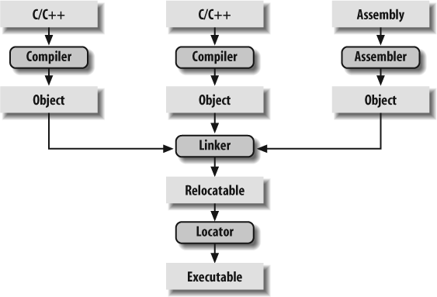
Code Execution at a glance
Figure 1.3, from the book Programming Embedded Systems, 2nd Edition by Anthony Massa, Michael Barr

Slide 10
Code Execution
Preprocessing - Processing where and what files are required, conditional blocks(if/else), macros etc.
Compiling - An object file is generated with the help of a compiler, this object file can not be understood by humans, assembly language is used by programmers to troubleshoot errors exist at this stage
Linking - A linker is used to bind any involved object files and/or libraries that have been used during the coding stages in order to produce a fully functioning executable that can be accessed/run.
Loading - When the executable is run (double-clicked), the executable is copied from hard disk to memory and then provided to the user.

Slide 11
Summary
Algorithms are not a definite requirement when it comes to development.
Algorithms are written in natural languages for inexperienced individuals to understand while the code variant is written in programming language(s) for programmers to understand.
Algorithms are a means of visualizing logic and outlining the necessary steps for intended output.
Coding revolves around a countless number of algorithms.
There is a flow during the process of coding and in execution of the written code.
Code can be run in a machine but an algorithm can’t.
Both the code variant and algorithms are direct deployments of the Software Development Life Cycle.

Slide 12
ALL RAW MATERIALS USED THROUGHOUT THE PRESENTATION BELONG TO THEIR RIGHTFUL OWNERS, I HAVE NOT IN ANY WAY INTENDED TO MAKE PROFIT OR ATTEMPTED TO CLAIM THEM AS MY OWN.
ALL LISTED OWNERS HAVE COMPLETE AUTHORITY OF ASSETS USED!
I HAVE SIMPLY ONLY MADE USE OF DISPLAYED ASSETS TO FURTHER MY PURPOSE OF PRESENTING EFFICIENTLY.

